Slide 1
WEB PAGE DEVOLPMENT WITH MOVIE RECOMMENDATION SYSTEM
Under the Guidance of
Dr.M. Munir Ahamed Rabbani ,
Professor,
Department of Computer Applications
BCA RRN: 201421601003 / 201421601006 1th Review

Slide 2
Modules
Modules:
Module I : Creating database.
Module II : Developing Web Application.
Module III : Creating self-updating algorithim with API.
Module IV : Creating Recommendation Algorithm
Module I: Creating Database:
The first module involves in creating the database for the web application.
Mysql query language is used to create and manipulate the database.
The database is named as moviesDB , and the table is named as movie_table.
The table contains columns like title,year,diretorname, actornames, keyword, genres etc.
BCA RRN: 201421601003/ 201421601006 1th Review

Slide 3
Modules
Module II: Developing Web Application:
This module involves in building a web application page , this module include both frontend and backend.
The front end of the application is created using HTML language and CSS.
Two front web pages are created, they are
Home page
Result page
The post method is used to push the searched keyword to backend and the searched result is displayed.
The Home page contains a search bar, and a button to get recommendation and a about page that describe about the web application.
The backend is create using python language and the packages used are flask and mysql and the libraries are Flask, mysql-connector, render_template, requests.
The flask package is used to create the backend as server that contains mysql query, it accept the post method from front end and performs query in backend.
The requests is used to handle the request between frontend and backend.
The render template is used to push the result to landing page.
The jsonify is used to send the data structured to the front end.
BCA RRN: 201421601003/ 201421601006 1th Review

Slide 4
Modules
Module III: Creating a self updating algorithim with API
This module involves in creating algorithim that scraps a web page and fetch content, structure it and store it in database.
This algorithm is fed with the IMDb web page URL and a time interval is given to the algorithm to perform the webscraping.
For webscraping python language is used with package Beautiful soup for webscraping and pandas to handle csv data.
And tweepy is used to fetch the comments and likes of the movie using the twitter developer account.
Module IV: Creating the recommendation system:
The recommendation system is build using python language.
The libraries used are
numpy
pandas
sklearn
The content based filtering method is used to produce recommendation, because it can handle large scale of data and users.
BCA RRN: 201421601003/ 201421601006 1th Review

Slide 5
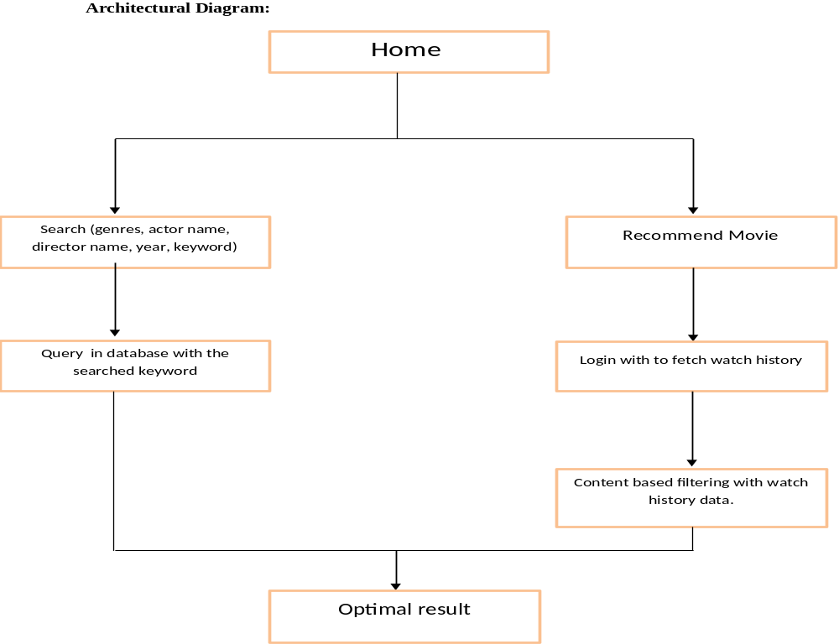
Architecture Diagram
BCA RRN: 201421601003/ 201421601006 1th Review

Slide 6
Backend code
from flask import Flask, render_template, request
import mysql.connector
import pdb
app = Flask(__name__)
# Define the route for the home page
@app.route('/')
def home():
return render_template('index.html')
# Define the route for the search page
@app.route('/search', methods=['POST'])
def search():
# Get the search keyword from the form data
keyword = request.form['search']
# Connect to the MySQL database
connection = mysql.connector.connect(host='localhost',
database='moviesdb',
user='root',
password='12345')
BCA RRN: 201421601003/ 201421601006 1th Review

Slide 7
Backend code
# Define a SQL query to search for the keyword in the database
# query = "SELECT * FROM movies_table WHERE actorname LIKE '%{}%'".format(keyword)
query = construct_query(keyword)
# Execute the query
cursor = connection.cursor()
cursor.execute(query)
# Get the search results
result = cursor.fetchall()
# Close the database connection
cursor.close()
connection.close()
# Render the search results template with the search results
return render_template('search.html', results=result)
def construct_query(keyword):
return "SELECT * FROM movies_table WHERE actorname LIKE '%{}%'".format(keyword)
if __name__ == '__main__':
app.run(debug=True)
BCA RRN: 201421601003/ 201421601006 1th Review

Slide 8
THANK YOU
BCA RRN: 201421601003/ 201421601006 1th Review

